Slide 1
Exploring Biases In AI Image Generation
By: De’Andre Brown, Shazadul Islam, and Valerii Panasenko

Slide 2
Introduction
1. Background:
- Artificial intelligence (AI) revolutionizes business and society.
- Generative AI offers transformative potential but also poses ethical challenges.
- Biased AI systems infringe upon human rights and spread societal inequalities.
- Our study investigates gender, race, and age biases in AI-generated images.
2. Research Questions:
- Does AI exhibit stereotypes and biases in image creation?
- Is there a biased attitude towards specific demographic groups?
3. Methodology:
- Analyze existing research on bias in AI systems.
- Compare AI-generated image dataset with demographic statistics from reliable sources.
- Assess whether AI-generated images accurately reflect real-world demographics.
4. Importance:
- Addressing biases in generative AI is crucial for equitable and inclusive outcomes.
- Ensuring AI serves everyone equally contributes to a more inclusive future.

Slide 3
Materials
A device with an internet connection
Access to Bing’s AI image creator, Designer, powered by Dall-E 3
A spreadsheet to track all of your data

Slide 4
Method
To gather our data, we each decided on the profession that we wanted to research. After trying out a few different professional terms, we decided to research the keywords boxer, chef, and librarian.
We decided on the artificial intelligence that we would use to generate our images for each profession. After thorough testing, we decided to use Bing’s image creator, Designer.
We generated one hundred images for each of our selected professions using the AI, saved and numbered each image in the order in which they were generated, and shared them with each other.
Once all the images were generated, we created a corresponding spreadsheet where we decided on the gender, ethnicity, and age of each person in each of the generated images.
Finally, we compiled all of this data into tables and graphs

Slide 5
Results
AI-Generated Image Gender Demographics |  | Professions
 |  | Boxer | Chef | Librarian
Genders | Male | 35 | 24 | 9
 | Female | 65 | 76 | 91

Slide 6
Results
AI-Generated Images Ethnicity Demographics |  | Professions
 |  | Boxer | Chef | Librarian
Ethnicities | White | 22 | 83 | 55
 | Black/African American | 69 | 12 | 27
 | Asian | 5 | 5 | 10
 | Hispanic/Latino | 4 | N/A | 5
 | Other | N/A | N/A | 3

Slide 7
Results
AI-Generated Images Age Demographics |  | Professions
 |  | Boxer | Chef | Librarian
Age Ranges | 20s-30s | 97 | 96 | 85
 | 40s-50s | 3 | 0 | 7
 | 60-70s | 0 | 4 | 8

Slide 8
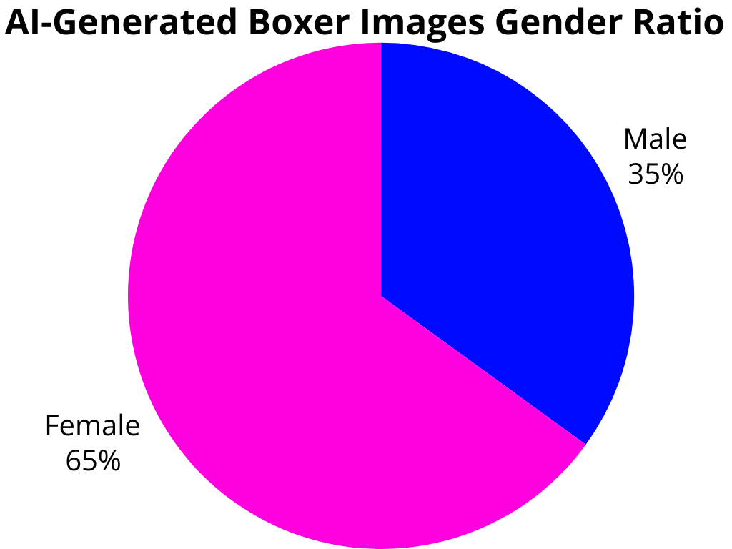
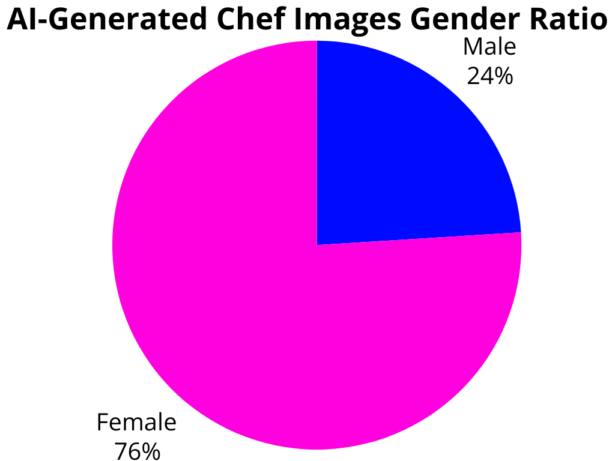
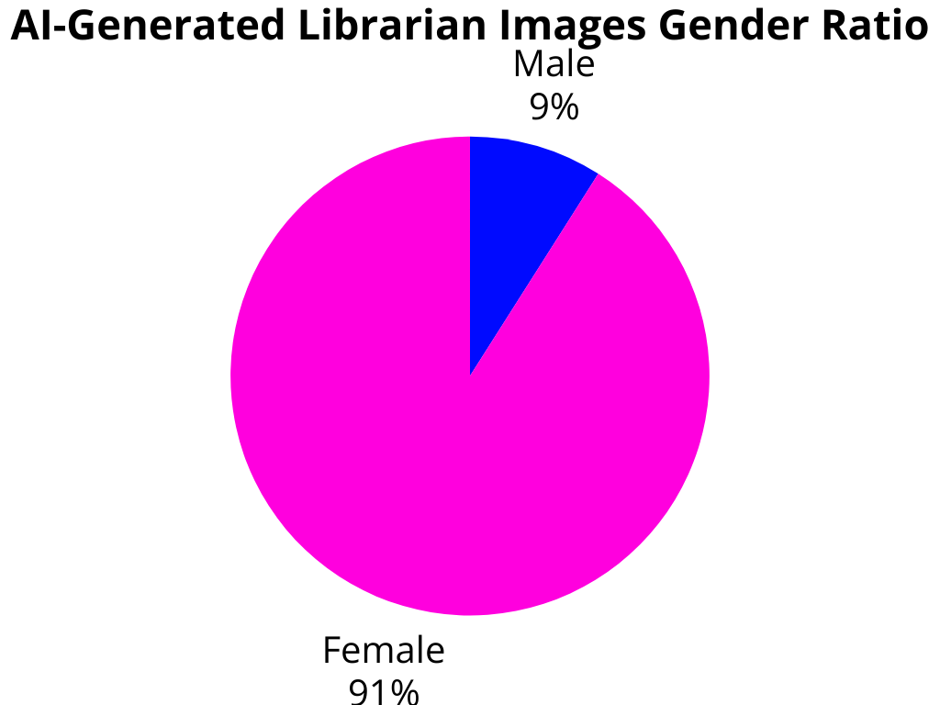
AI-Generated Images Gender Demographics Graphs

Slide 9
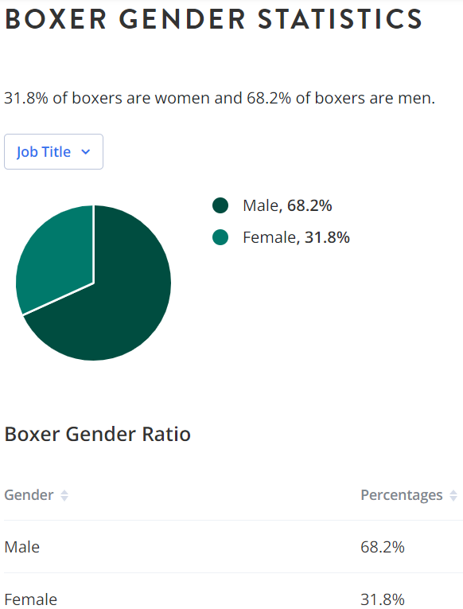
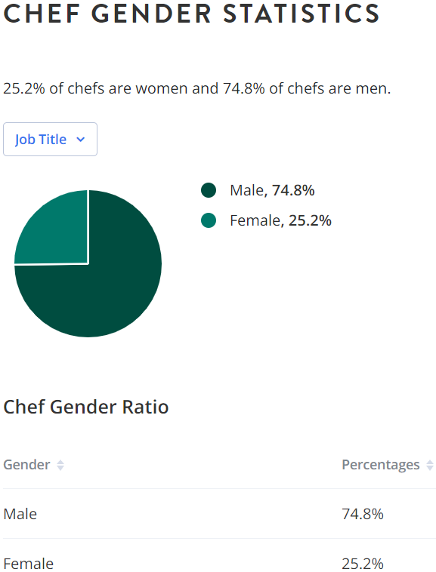
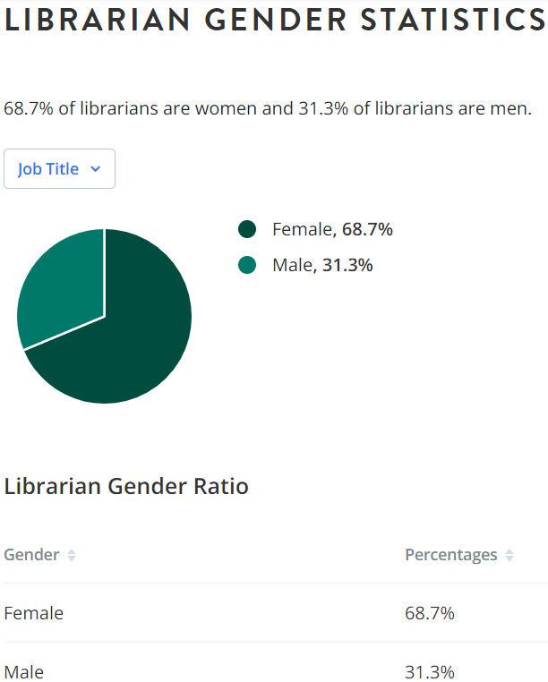
Real Gender Demographics

Slide 10
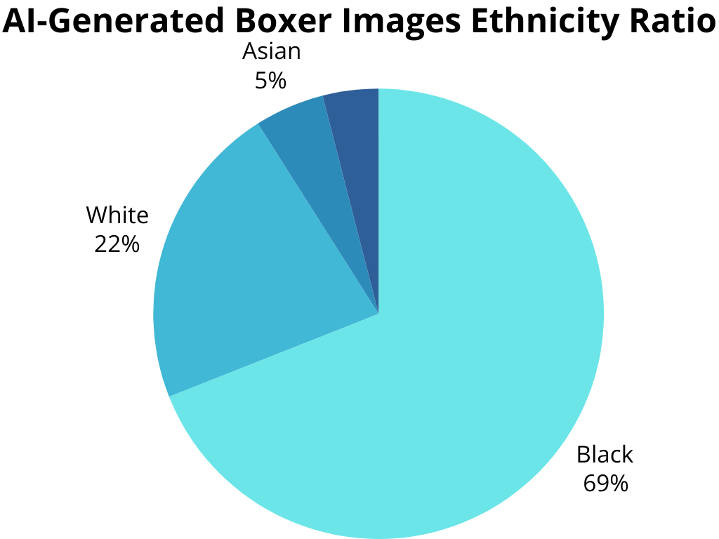
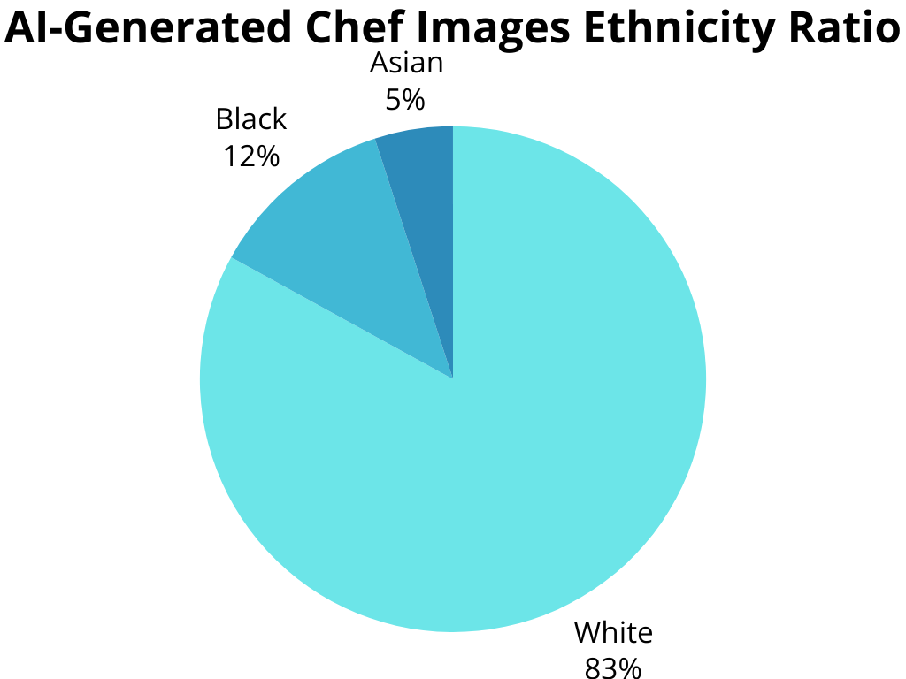
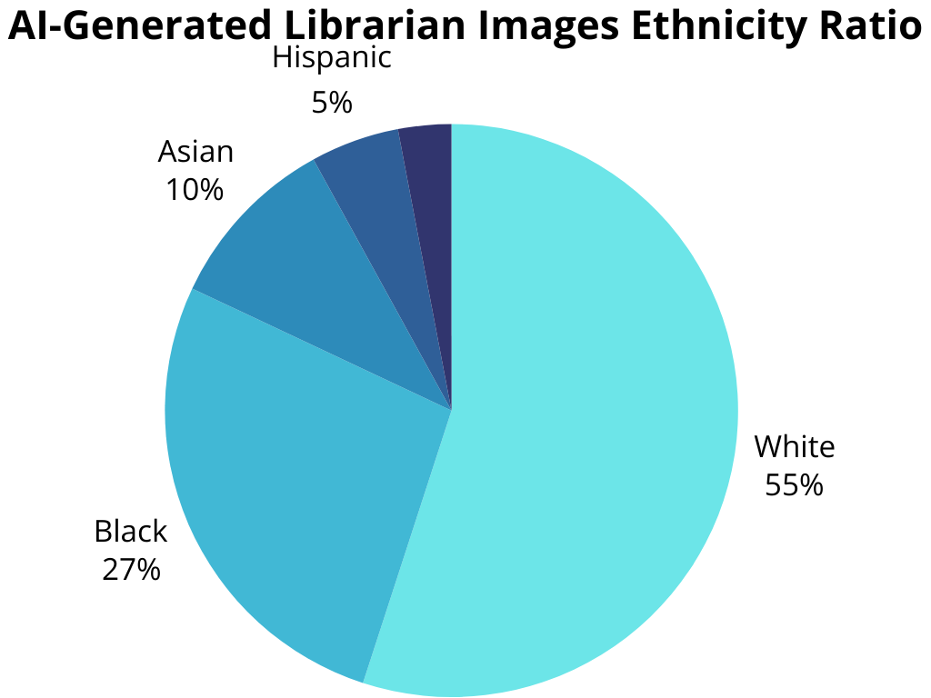
AI-Generated Images Ethnicity Demographics Graphs

Slide 11
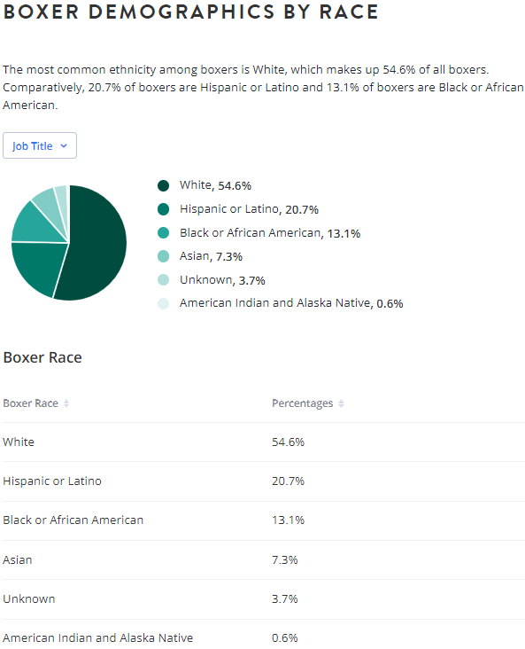
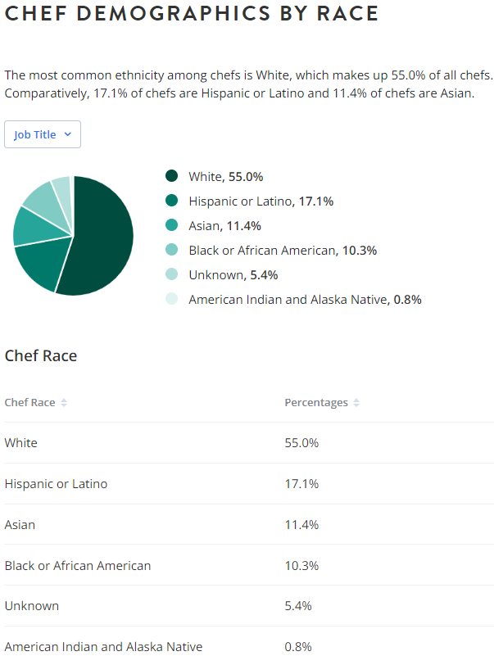
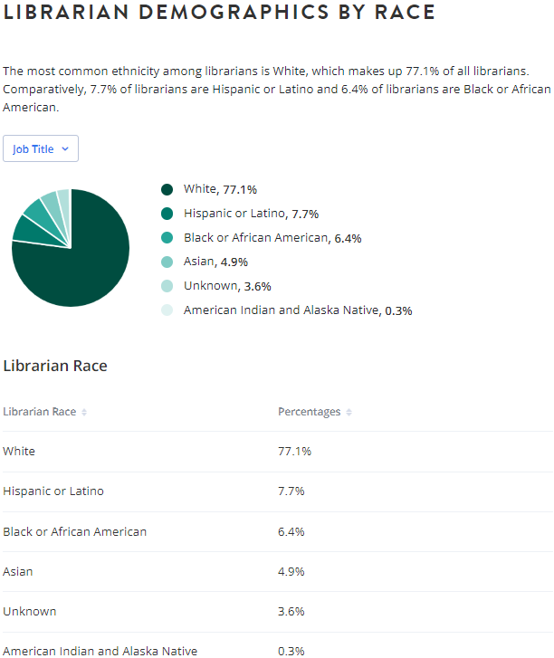
Real Ethnicity Demographics

Slide 12
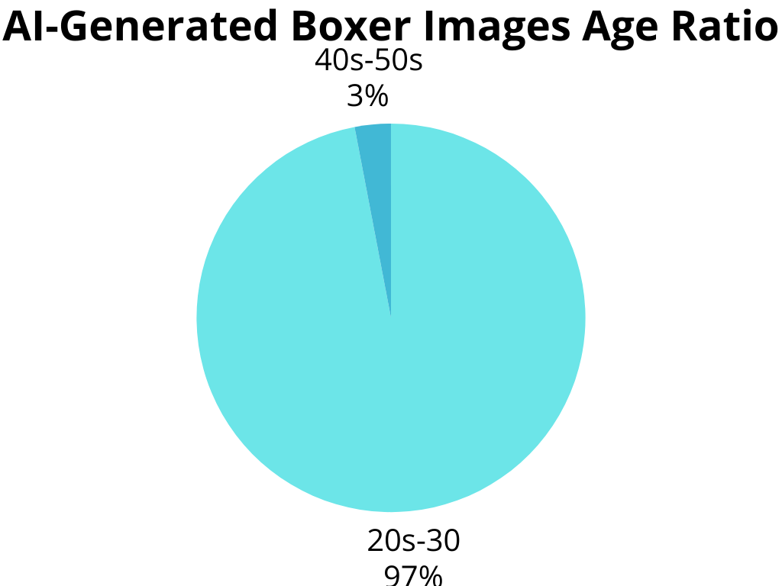
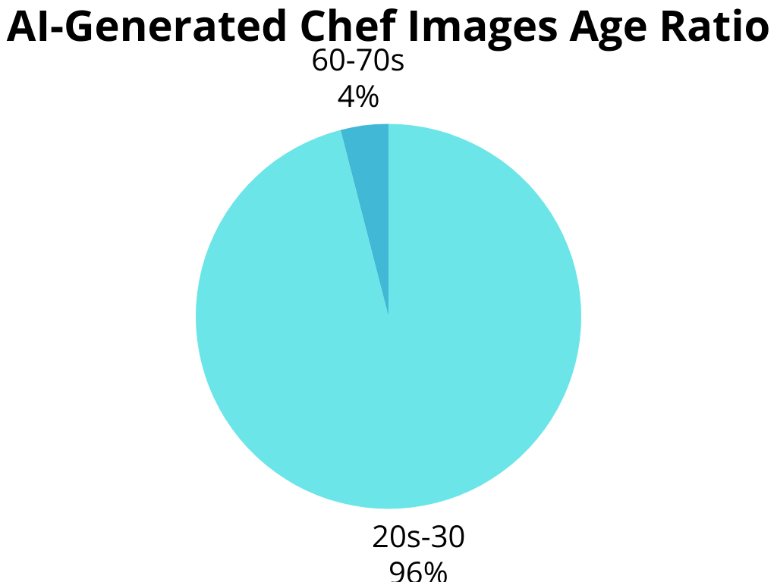
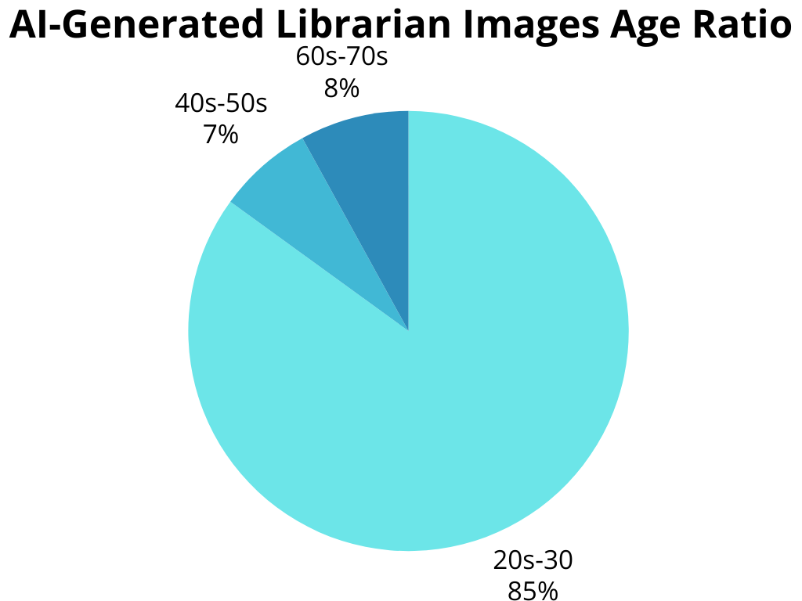
AI-Generated Images Age Demographics Graphs

Slide 13
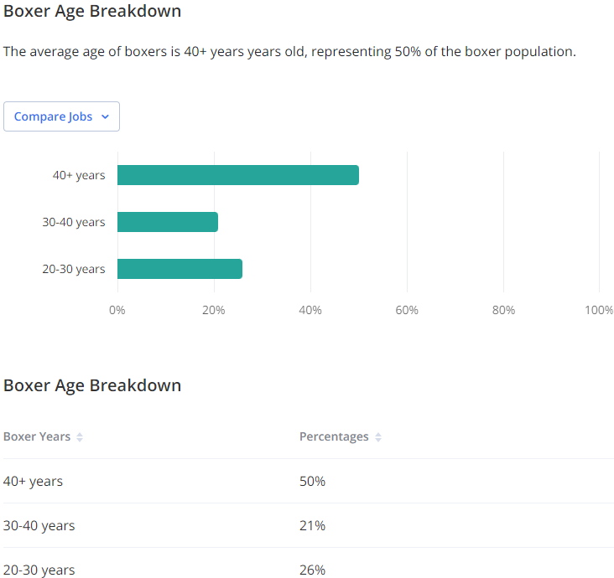
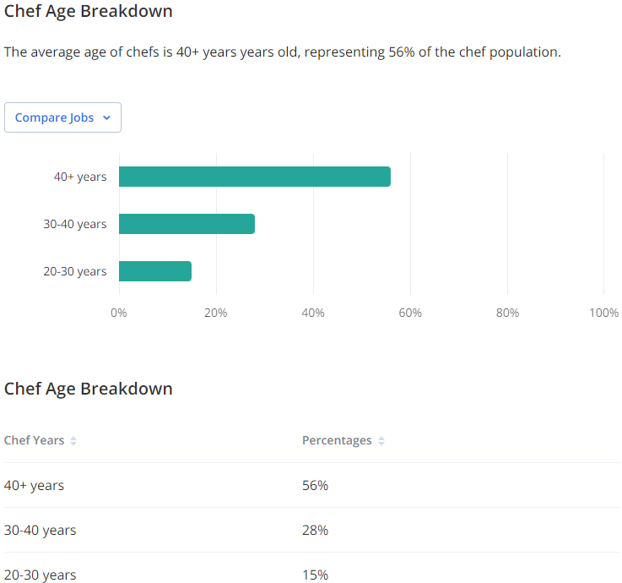
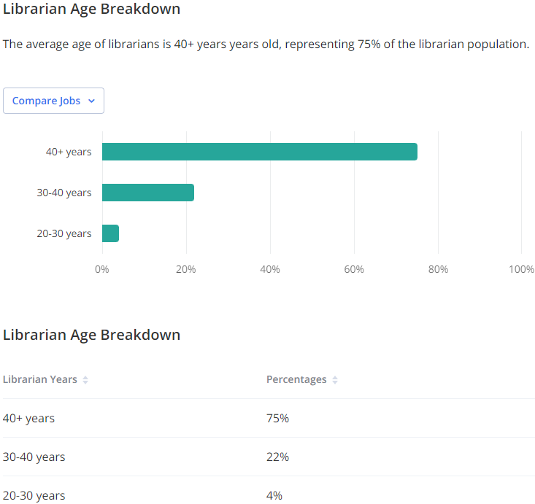
Real Age Demographics

Slide 14
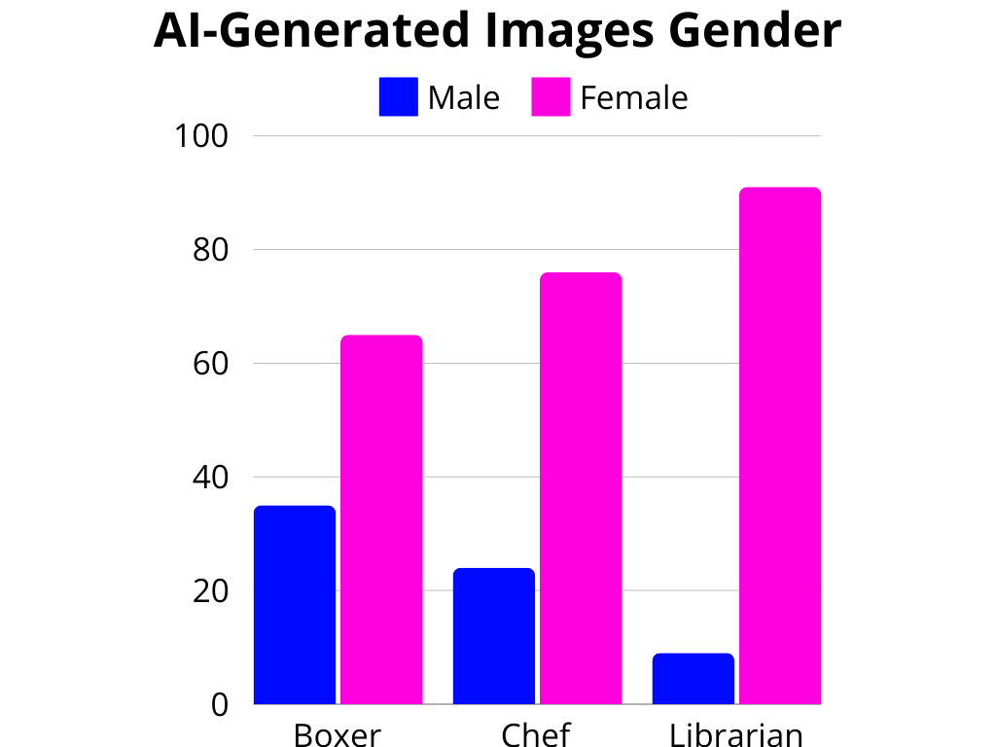
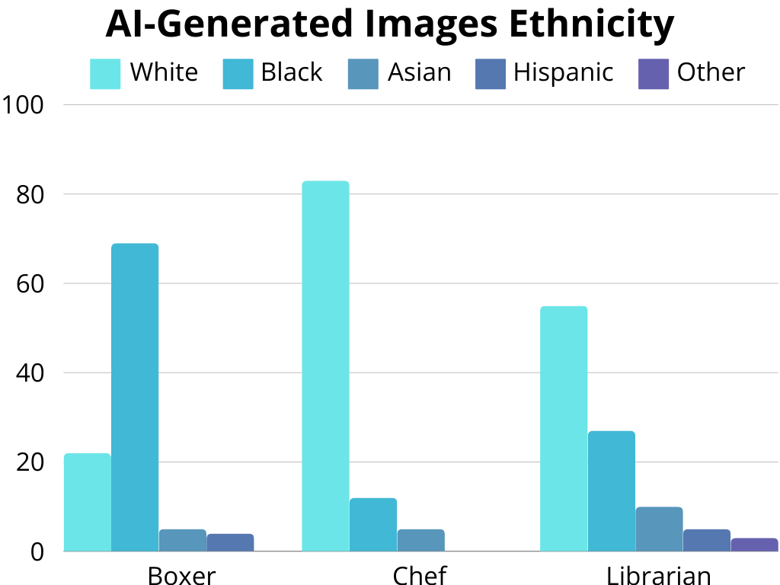
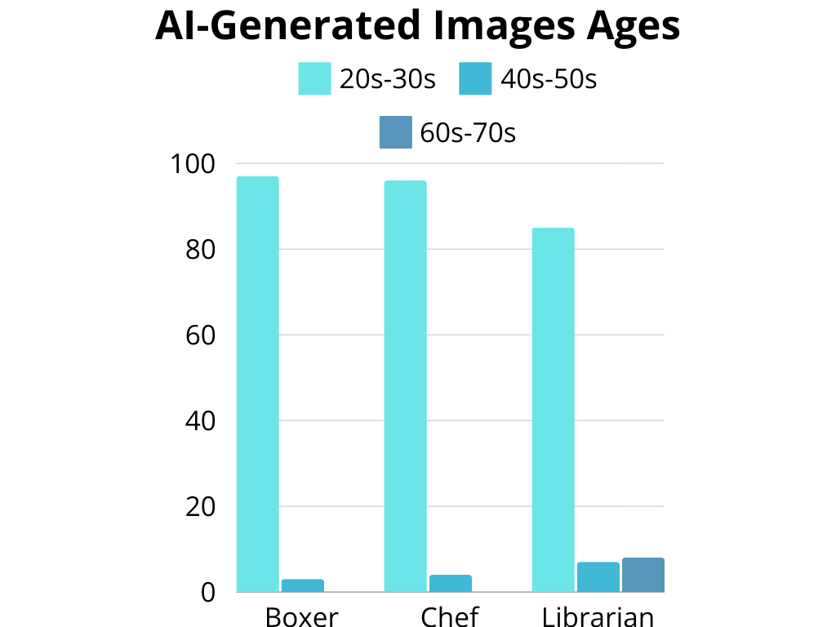
AI-Generated Profession Images Comparison Graphs

Slide 15
Discussion
Our gathered data, showed a significant bias within Gender, Age, and Ethnicity
Gender
Data gathered from the AI-generated boxer images misrepresented a male dominated sport by producing a majority female result.
Our AI-generated chef images presented us with the same misrepresentation.
In contrast, the AI-generated Librarian images produced a 91% Female population, while the real data shows it’s closer to 68.7%
Ethnicity
According to boxer demographics by Zippia, 54.6% are White, whereas our AI-generated data gave us a result of 22% of the total being white.
Of the images of chefs generated, 83% of them were White,12% Black, and 5% Asian. Zippia reports 55% of chefs are White, 17.1% Latinx, 11.4% Asian, and 10.35 Black.
AI-generated images of librarians brought back an inconsistent result, showing us 55% White, 27% Black, whereas according to Zippia, 77.1% are White, and 6.4% are Black.
Age
Age bias in AI-generated boxer images depicted younger adults 97% of the time whereas, the real world only shows 26% being between 20-30, and the higher average of 50% belonging to boxers over 40 years old.
This trend followed in our AI-generated chef images, giving us a result of 94% being between 20-30, and only 6% being above 60.
Our librarian images also gave us a result of 85% being young people, when the real world data shows that 75% of librarians are in their 40s or higher.

Slide 16
Conclusion
What we Learned:
The goal of this experiment was to find biases within AI and consider how that can have an impact as it grows to become a staple throughout the world. In terms of generative art, it can be extremely difficult to find consistent data sets that line up with real-world standards. It tends to skew itself towards one gender over the other rather than depicting a more diverse amount of them all. AI image generation often misrepresents or doesn’t include certain demographics as clearly as Black, White, and Asian people. Demographics, such as Latinx, Middle Eastern, and Native people are often marginalized, depicted ambiguously, omitted entirely. Even with age, it tends to produce younger people in their 20s-30s, even when real demographic data and our population exhibits a large diversity of all ages.
How to Move Forward:
To summarize, addressing AI prejudice is critical not only for technological growth but also for protecting human rights and creating a fair and just society. Future research and policies must reflect the far-reaching consequences of bias while aiming for transparency, fairness, and accountability in AI systems.

Slide 17


